Slide 1
React & JS
clean code

Slide 2
Before dev
Add the right tools
Make dev protocols and chart

Slide 3

Eslint
Static code analysis.
Discover problems with JavaScript code without executing it.
Add a like a light compilation layer to JS : without the benefit of a compilation process, JS code is typically executed in order to find syntax or other errors.
Ensure the respect of JS standard coding.
Not only linter but also formatter.
Extendable and customizable.
ESLint is written using Node.js to provide a fast runtime environment and easy installation via npm.
Is not an option but a mandatory and required tool !
Preconfigured inside an awt-react using Airbnb configuration by default.
The first coding protocole between team
npm run lint
https://eslint.org/docs/about/
https://github.com/airbnb/javascript
https://eslint.org/docs/rules/
https://typescript-eslint.io/rules/

Slide 4
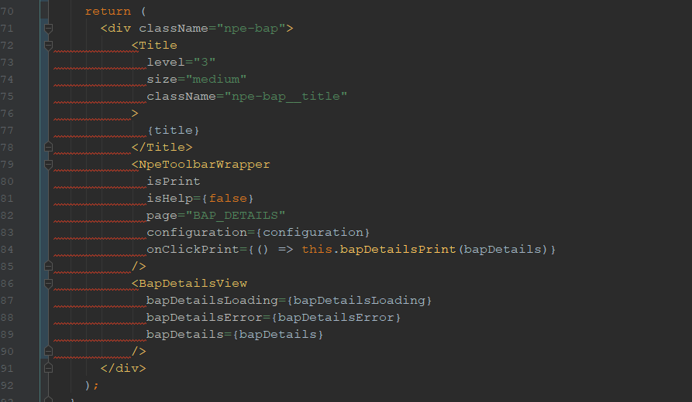
Eslint
Is not an option but a mandatory and required tool !
Preconfigured inside an awt-react using Airbnb configuration by default.
npm run lint

Slide 5
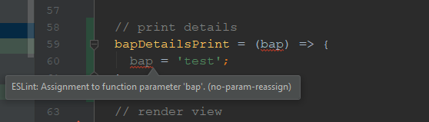
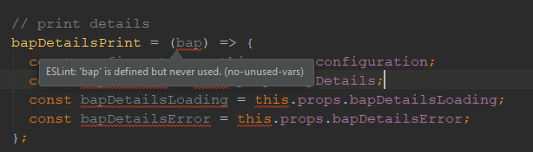
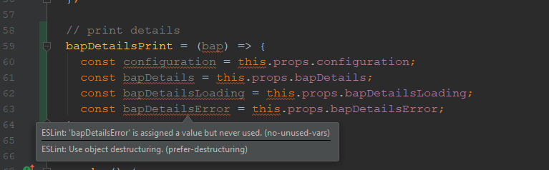
Eslint
Is not an option but a mandatory and required tool !
Preconfigured inside an awt-react using Airbnb configuration by default.
npm run lint

Slide 6
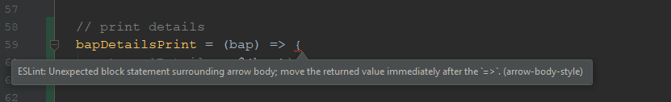
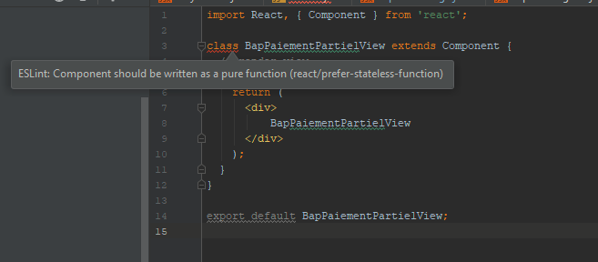
Eslint
// print details bapDetailsPrint = (bap) => { return `Details : ${bap}`; };
Is not an option but a mandatory and required tool !
// print details bapDetailsPrint = bap => `Details : ${bap}`;
import React, { Component } from 'react'; class BapPaiementPartielView extends Component { // render view render() { return ( <div> BapPaiementPartielView </div> ); } } export default BapPaiementPartielView;
Preconfigured inside an awt-react using Airbnb configuration by default.
npm run lint

Slide 7
Eslint
Is not an option but a mandatory and required tool !
/* eslint-disable-next-line */
// eslint-disable-next-line func-names
Preconfigured inside an awt-react using Airbnb configuration by default.
npm run lint

Slide 8
Eslint
// eslint-disable is not recommended but we need this because // sg-components-styles is not explicitly installed but checked // from sg-components /* eslint-disable-next-line */ import 'sg-components-styles/dist/variables/_index.scss'; // eslint-disable is not recommended but we need this because // sg-components-styles is not explicitly installed but checked // from sg-components /* eslint-disable-next-line */ import 'sg-components-styles/dist/core/_index.scss';
Is not an option but a mandatory and required tool !
Preconfigured inside an awt-react using Airbnb configuration by default.
If you haven’t another choice, explain the raison to disable
We share code between us => avoid bad practices propagation
npm run lint

Slide 9
Husky git hooks
new husky
http://socle.applis.bad.socgen/icd/demo/#/awt_5.2_react_modernisation?id=modernisation-de-la-configuration-husky
#!/bin/sh if [ -z "$husky_skip_init" ]; then debug () { if [ "$HUSKY_DEBUG" = "1" ]; then echo "husky (debug) - $1" fi } readonly hook_name="$(basename "$0")" debug "starting $hook_name..." if [ "$HUSKY" = "0" ]; then debug "HUSKY env variable is set to 0, skipping hook" exit 0 fi if [ -f ~/.huskyrc ]; then debug "sourcing ~/.huskyrc" . ~/.huskyrc fi export readonly husky_skip_init=1 sh -e "$0" "$@" exitCode="$?" if [ $exitCode != 0 ]; then echo "husky - $hook_name hook exited with code $exitCode (error)" fi exit $exitCode fi
#!/bin/sh . "$(dirname "$0")/config/husky.sh" cd modules/front-js npm run lint
#!/bin/sh . "$(dirname "$0")/config/husky.sh" cd modules/front-js npm run test
Preconfigured inside awt-react

Slide 10
Husky git hooks
legacy husky
"husky": { "hooks": { "pre-commit": "npm run lint", "pre-push": "npm run test" } },
npm install husky --save-dev
Preconfigured inside awt-react

Slide 11
Husky git hooks
#!/bin/sh . "$(dirname "$0")/config/husky.sh" cd modules/front-js #npm run lint
"husky": { "hooks": { } },
#!/bin/sh . "$(dirname "$0")/config/husky.sh" cd modules/front-js #npm run test

Slide 12
Before using a package
External packages

Slide 13
Can I do it by myself ?
Stay close to native APIs to benefits from Node ecosystem optimizations

Slide 14
Already exist ?
https://sgithub.fr.world.socgen/pages/SocleDigitalClient/sg_npm_dgt_awt_react-extras/index.html

Slide 15
Package weight ?
https://bundlephobia.com/

Slide 16
Can I use it ? (browsers compatibility)
https://caniuse.com/
https://developer.mozilla.org/en-US/docs/Web/JavaScript
https://babeljs.io/docs/en/plugins-list
https://github.com/zloirock/core-js

Slide 17
Bundle analyze
npm run analyze

Slide 18
dev

Slide 19
Keep the console open
React warning, React deprecation, Proptypes warning, …

Slide 20
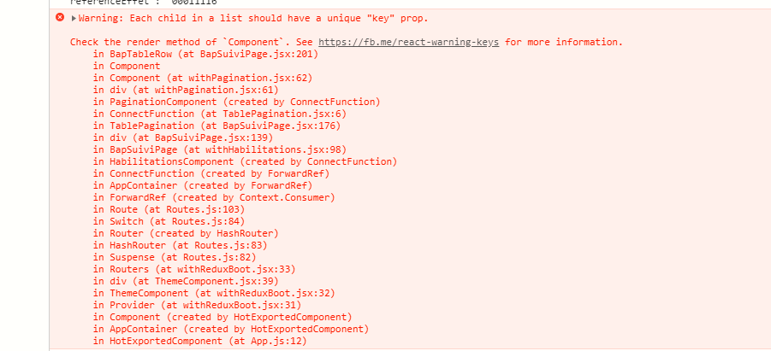
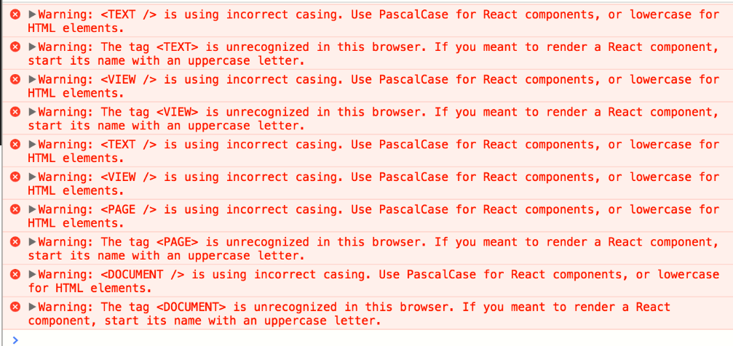

Slide 21
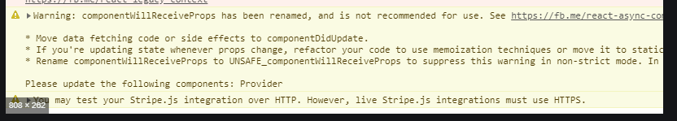
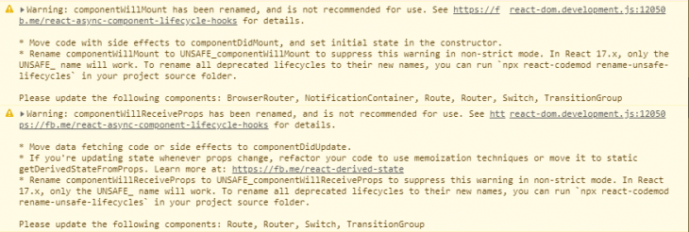

Slide 22
Define a coding protocol
Naming conventions, coding style, module, standard …
https://xblocks.socgen/#/client/awt-react-clean-code-normes

Slide 23
Naming convention
Choose a correct name to avoid question, don’t let reviewer read all code to understand what function should do

Slide 24
Naming convention
self-documented code
formatMontant(montant)
formatEmetteur(emetteur)
caculateXY(x,y)
const day, month, year
const montant, emetteur
const d, y, z
const value1, value2
const titre, Titre

Slide 25
Functional programinng
Avoid mutability, impure, side effects and maximise reusability and generic code

Slide 26
Test standalone function
https://jsfiddle.net/

Slide 27
Declarative over imperative
Less code, more readability, reuse, …

Slide 28
Proptypes validation
http://socle.applis.bad.socgen/icd/demo/#/client/awt-v4-react-proptypes-validation.md

Slide 29
You don’t need to use window
const gdaCheckSign = ( configuration, token, onCheckSignSuccess ) => { // l'utilisation de window est non recommandé // on est obligé dans ce contexte d'utiliser // window car le gda est injecté dans le window if (window.gda_check_sign) {
/** * React router is made for * single page, to open new app * we should use window.local * @param url */ const navigateToURL = (url) => { // l'utilisation de window est non recommandé // on est obligé dans ce cas d'utiliser // window car au niveau du portail on change // totalement de page et on perd le contexte // single page window.location.href = url; };
If you haven’t choice explain the raison why !

Slide 30
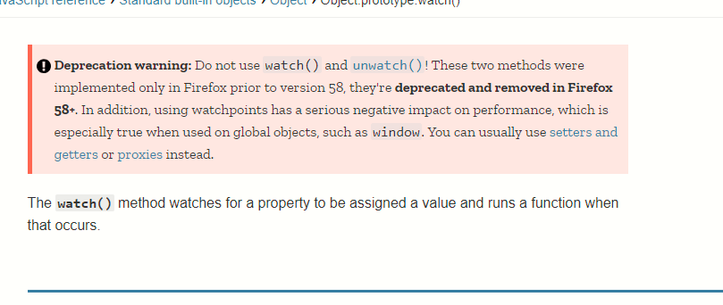
Read very well documentation
https://developer.mozilla.org/en-US/docs/Web/JavaScript

Slide 31
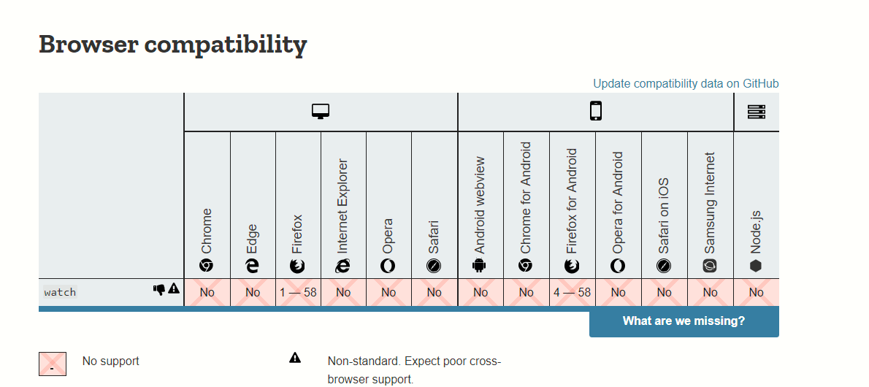
Read very well documentation
https://developer.mozilla.org/en-US/docs/Web/JavaScript

Slide 32
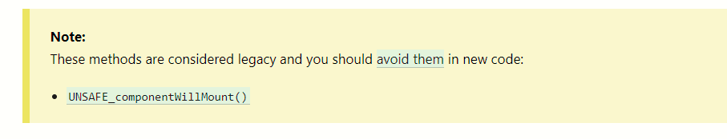
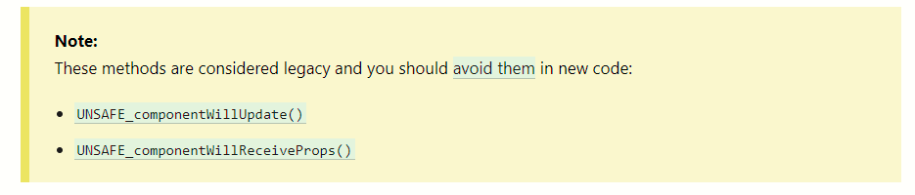
Read very well documentation
https://fr.reactjs.org/docs/react-component.html

Slide 33
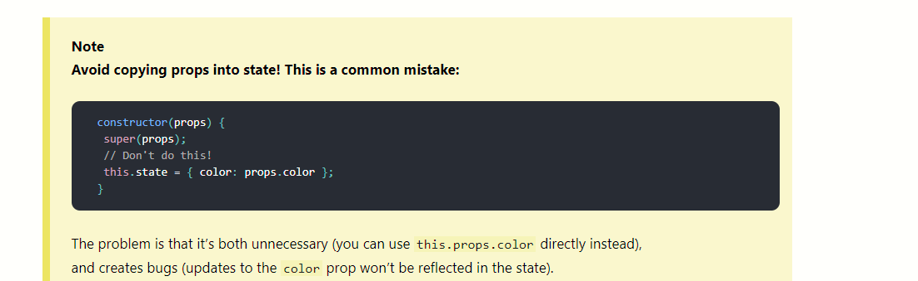
Read very well documentation

Slide 34
You should never push console.log
ESLint will verify this for you, never disable it !
Use common.log

Slide 35
Verify browser compatibility
Test your code on chrome, firefox, IE

Slide 36
Check performance with devtools
Detailed during next session

Slide 37
Unit test
React Application
Mandatory
Mandatory
Jest is preconfigured inside an awt-react
Functional Components
Redux & services
npm run test
Page
npm run test:update
npm run test:coverage
Jest + redux-test-plan
Jest + chai + enzyme
Jest snapshot
http://socle.applis.bad.socgen/icd/demo/#/client/awt-v4-react-unit-test.md

Slide 38
Unit test
FUNCTIONAL COMPONENT : WHAT WE TEST ?
Change props and test expected app display
BLACK BOX
Jest is preconfigured inside an awt-react
props (inputs)
actions (outputs)
npm run test
npm run test:update
Component purity
View structure
Expected display formatting
npm run test:coverage
Enzyme mount : mount the whole component like React VDOM. So all utils and config class will been covered with.

Slide 39
Unit test
Redux & Services : WHAT WE TEST ?
Change response and actions and test expected app state
Jest is preconfigured inside an awt-react
Success
Fail
Exception
npm run test
npm run test:update
npm run test:coverage
Expected store state
Expected reducer actions
Response correct formatting
All utils and config class will been covered with.

Slide 40
describe('Bap Suivi Service', () => { it('Bap Suivi (success)', () => { const fakeAction = { type: 'BAP_SUIVI_REQUEST', }; const fakeSuccessResponse = { data: { ...bapSuiviList, }, }; const { data, } = fakeSuccessResponse; const { donnees: suiviList, } = data; return (expectSaga(BapSuiviService, fakeAction) .withReducer(PaginationReducer) .provide([ [matchers.call.fn(getBaseUrl), '/icd/npe/'], [matchers.call.fn(bapSuiviQuery), fakeSuccessResponse], ]) .put({ type: 'PAGINATION_DATA_SOURCE', suiviList, }) .hasFinalState({ loading: false, suiviListData: suiviList, suiviList: suiviList.slice(0, 20), suiviListPage: 0, suiviListShowInfoMessage: false, suiviListShowPagination: false, suiviListShowLastPage: false, suiviListShowNextPage: false, error: null, }) .run()); });
it('Bap Releves En Attente (success)', () => { const fakeAction = { type: 'BAP_RELEVES_REQUEST', }; const fakeSuccessResponse = { data: { ...bapSuiviList, }, }; const { data, } = fakeSuccessResponse; const { donnees: suiviList, } = data; return (expectSaga(BapSuiviService, fakeAction) .withReducer(PaginationReducer) .provide([ [matchers.call.fn(getBaseUrl), '/icd/npe/'], [matchers.call.fn(bapSuiviQuery), fakeSuccessResponse], ]) .put({ type: 'PAGINATION_DATA_SOURCE', suiviList, }) .hasFinalState({ loading: false, suiviListData: suiviList, suiviList: suiviList.slice(0, 20), suiviListPage: 0, suiviListShowInfoMessage: false, suiviListShowPagination: false, suiviListShowLastPage: false, suiviListShowNextPage: false, error: null, }) .run()); });

Slide 41
Write tests and mesure coverage to enhance
npm run test:coverage

Slide 42
Projects references
https://sgithub.fr.world.socgen/AppliDigitalClient/bddf_awt_wtr

Slide 43
Socle doc references
http://socle.applis.bad.socgen/icd/demo/#/client/awt-v4-react-unit-test.md

Slide 44
Before PR
Before asking pr review

Slide 45
Bundle analyze
npm run analyze

Slide 46
React JS Checklist
http://socle.applis.bad.socgen/icd/demo/#/client/awt-v4-react-checklist.md

Slide 47
Challenge your PR

Slide 48
Stay Hungry, Stay Foolish !
Twitter and github
http://esnextnews.com/
https://medium.com/@_ericelliott
https://me.getify.com/
https://overreacted.io/

Slide 49
Thank you
Any question ?

